Slide 1
#VapeVeritas NLP-Powered Surveillance of E-cigarette Information on Twitter
Alexander Xu
Great Neck South High School, Great Neck, NY
S.-T. Yau High School Science Award North America
November 18th, 2023

Slide 2
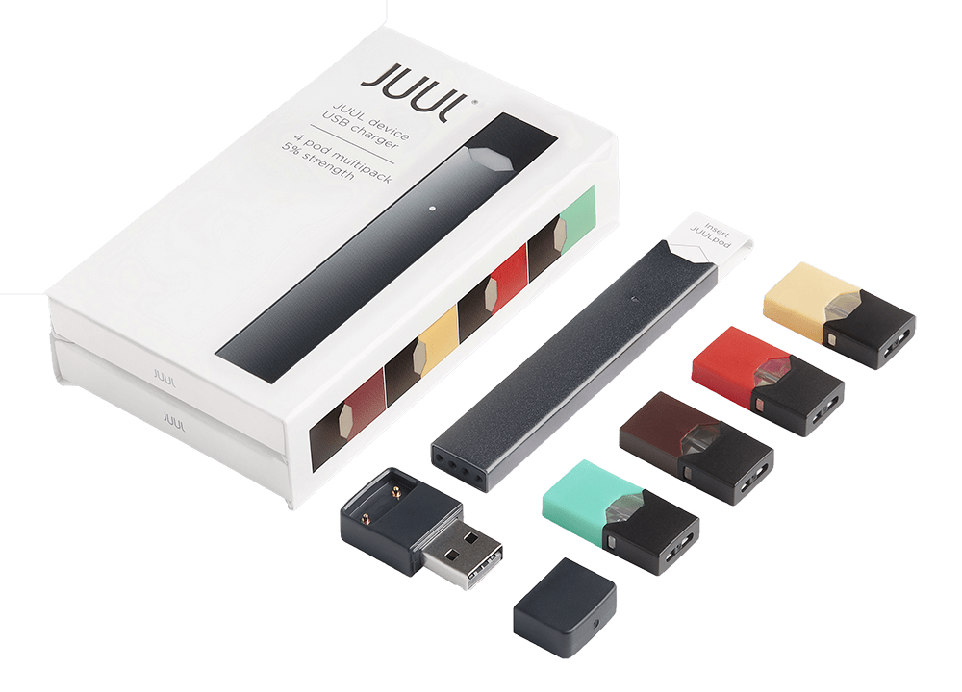
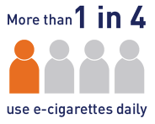
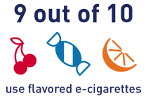
The E-Cigarette Epidemic: A Growing Concern
E-cigarettes (ECs) (Huang et al., 2019; Jackler et al., 2019; Malik et al., 2019)
Sleek designs
Appealing flavors
Targeted marketing
Health risks (Casey & Jones, 2010; Demissie et al., 2017; Soneji, 2017)
Nicotine addiction
Impaired neurodevelopment
Exposure to toxic metals
7.7% of American students (2.13 million) vape (“Results from the Annual National Youth Tobacco Survey”, 2023)
JUUL, a leading EC brand. C/O Juul Labs (2023)
Among youth EC users…
Figure adapted from National Youth Tobacco Survey (2023)

Slide 3
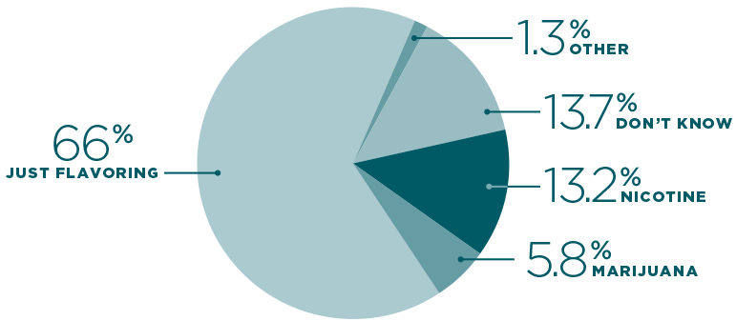
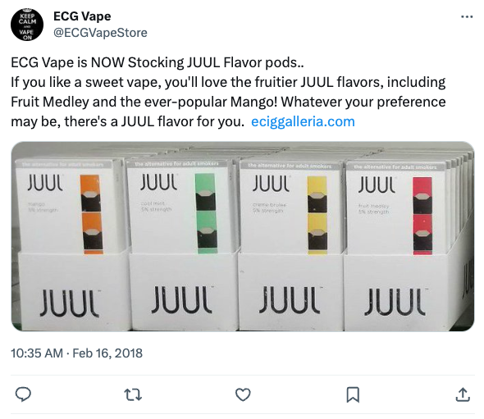
Social Media Misinformation and Public Health Surveillance
Positive perception, risk misconceptions (Camenga et al., 2018; Pepper and Farrelly et al., 2018)
Lack of reliable info
Social media ads ⇒ usage
Twitter surveillance (Myslín et al., 2013; Sloan et al., 2015)
Large corpus of raw content
60% of Twitter users are <30 y.o.
NLP effective tool (Jordan et al., 2018; Edo-Osagie et al., 2020; Visweswaran et al., 2020)
Past event and method specific surveillance (Allem et al., 2017; Allem et al., 2018; Ahmed et al., 2020; McCausland et al., 2020; Gao et al., 2021; Majmundar et al., 2021)
What teens believe is in EC vapor. C/O National Institute on Drug Abuse (2018)
Example of a EC related Tweet:

Slide 4




Data Source and Inclusion Criteria
Twitter
Tweet Criteria
E-cig keywords
1/1/15 to 12/1/23
English language
Unique content

Slide 5
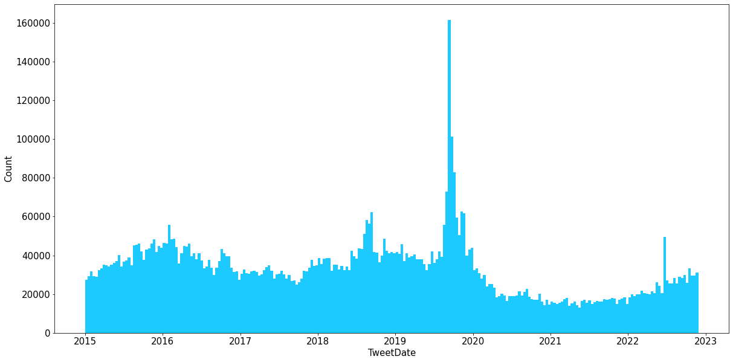
Selected Tweets Overview
8,077,408 Tweets
E-cigarette use-associated lung injury outbreak (EVALI)
FDA declares E-cig usage is an epidemic
JUUL marketing denial order (MDO)

Slide 6
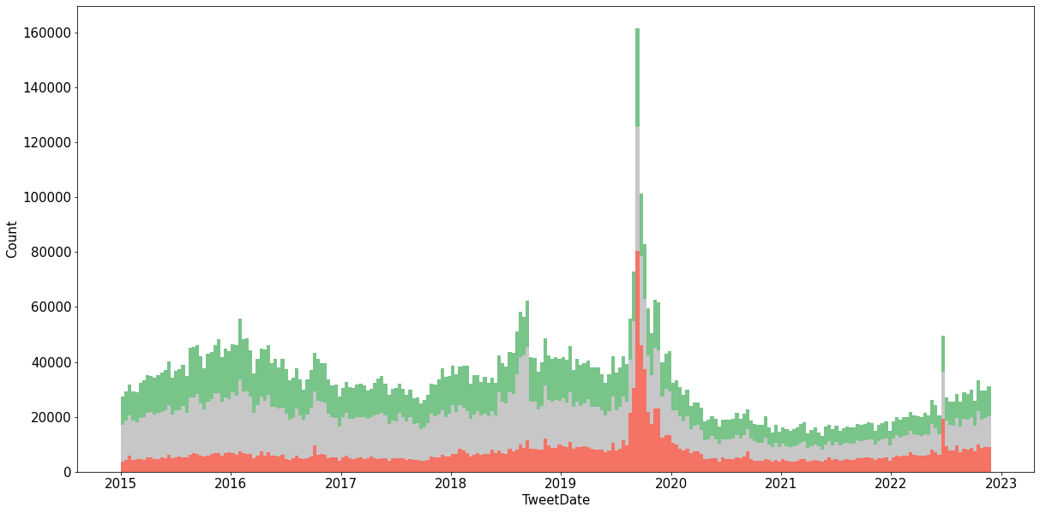
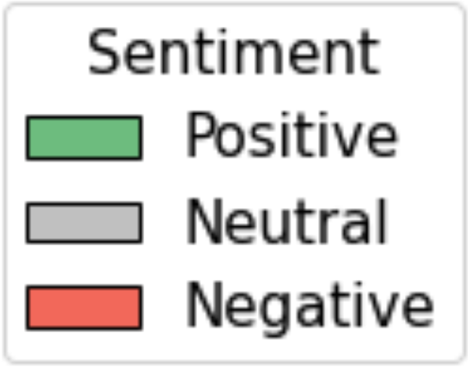


E-cigarette Sentiment Trends Over Time
Valence Aware Dictionary for sEntiment Reasoning (VADER), rule-based (Hutto & Gilbert, 2014)
8,077,408 Tweets
2,888,729 (35.8%) Pos 3,400,582 (42.1%) Neutral 1,788,097 (22.1%) Neg
4,546 ⇨ 5,954 tweets/day
16.2% ⇨ 36.9% neg sentiment
+0.5983
-0.3612

Slide 7
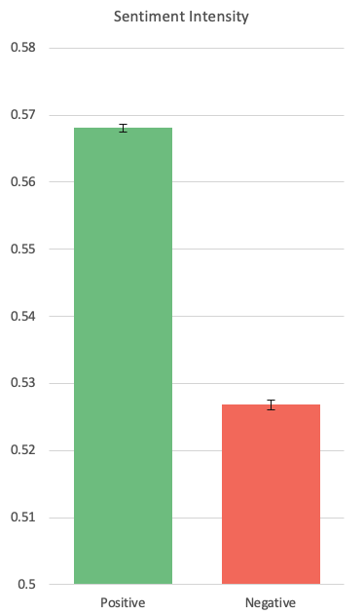
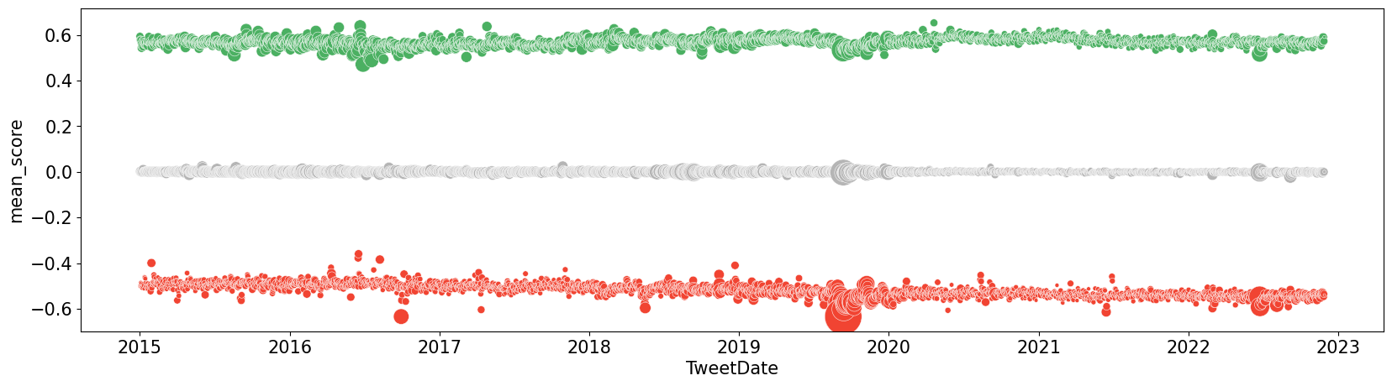
Sentiment Polarization
(A)
p<0.001
-1.6 stdev
R²=0.051
p<0.001
+0.002/yr
(B)
R²=0.539
p<0.001
-0.009/yr
-2.5 stdev

Slide 8
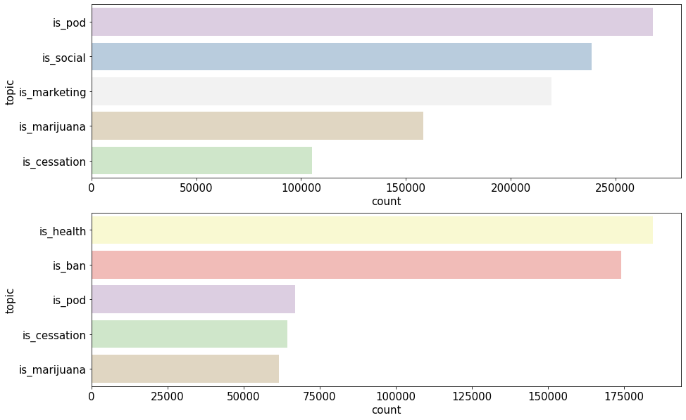
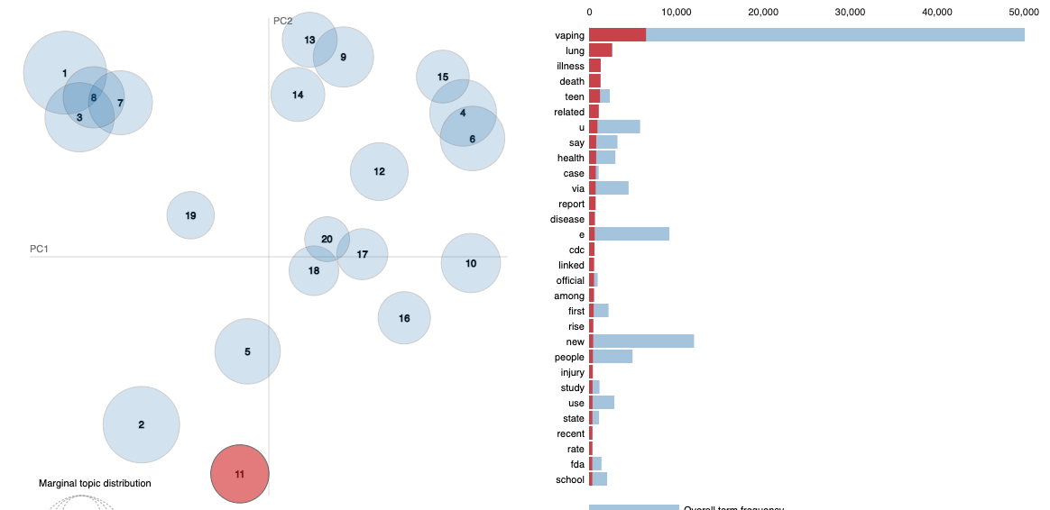
Topics Associated with Sentiment
Latent Dirichlet Allocation (LDA), statistical (Prier et al., 2011)
“There is a growing number of severe lung illness cases related to using e-cigarette and vaping products”
Topic: “health”

Slide 9
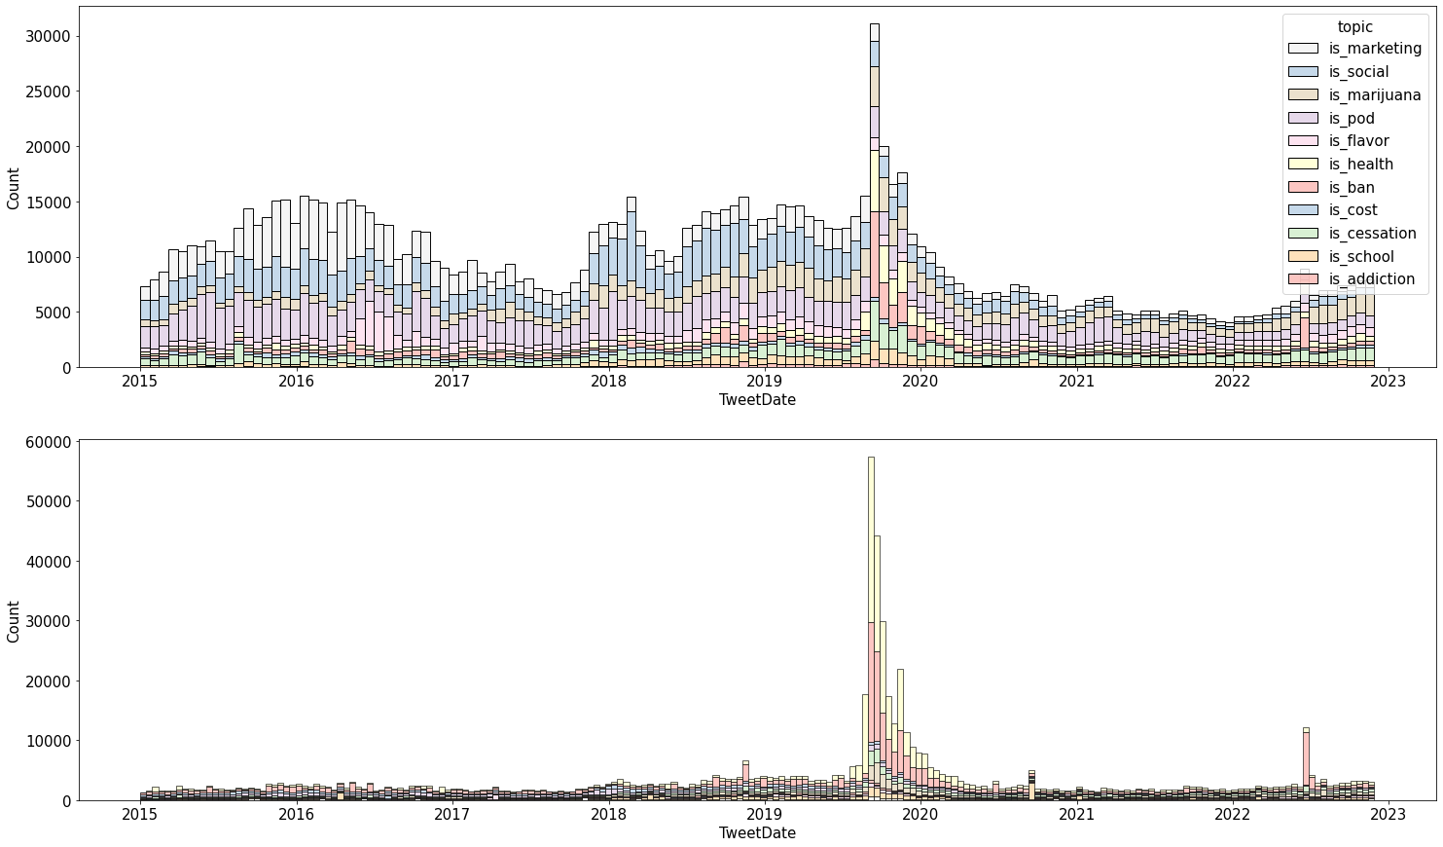
Large-Scale Evidence Supporting Key Paper
E-cigarette use-associated lung injury outbreak (EVALI)
JUUL marketing denial order (MDO)

Slide 10
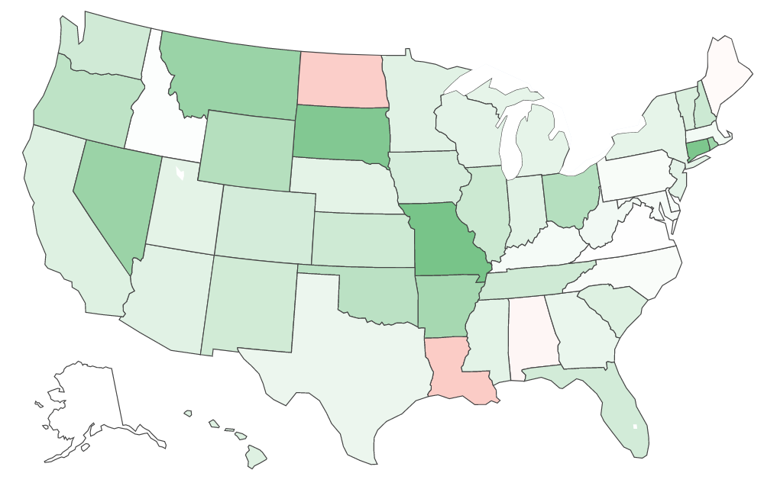
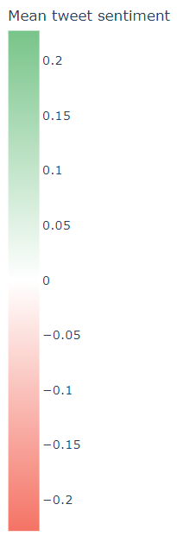
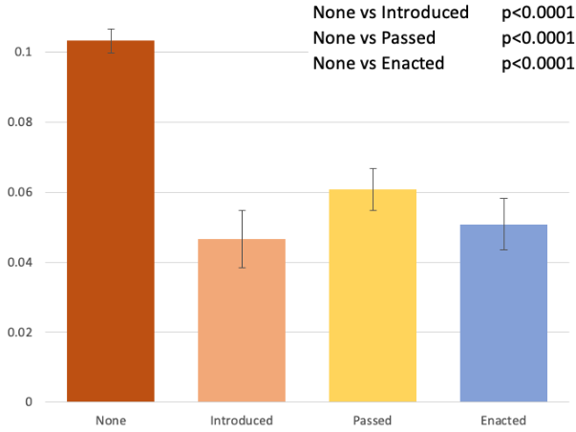
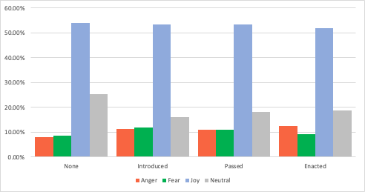
State Policy Linked to Sentiment and Emotion
Mean sentiment by state policy
Mean sentiment
χ²=128.19 p<0.001
Emotion by state policy
BERT, transformer (Saravia et al., 2018)
Emotion intensity dataset (Sailunaz & Alhajjab, 2019)
Testing F1-score of all classes >0.85

Slide 11
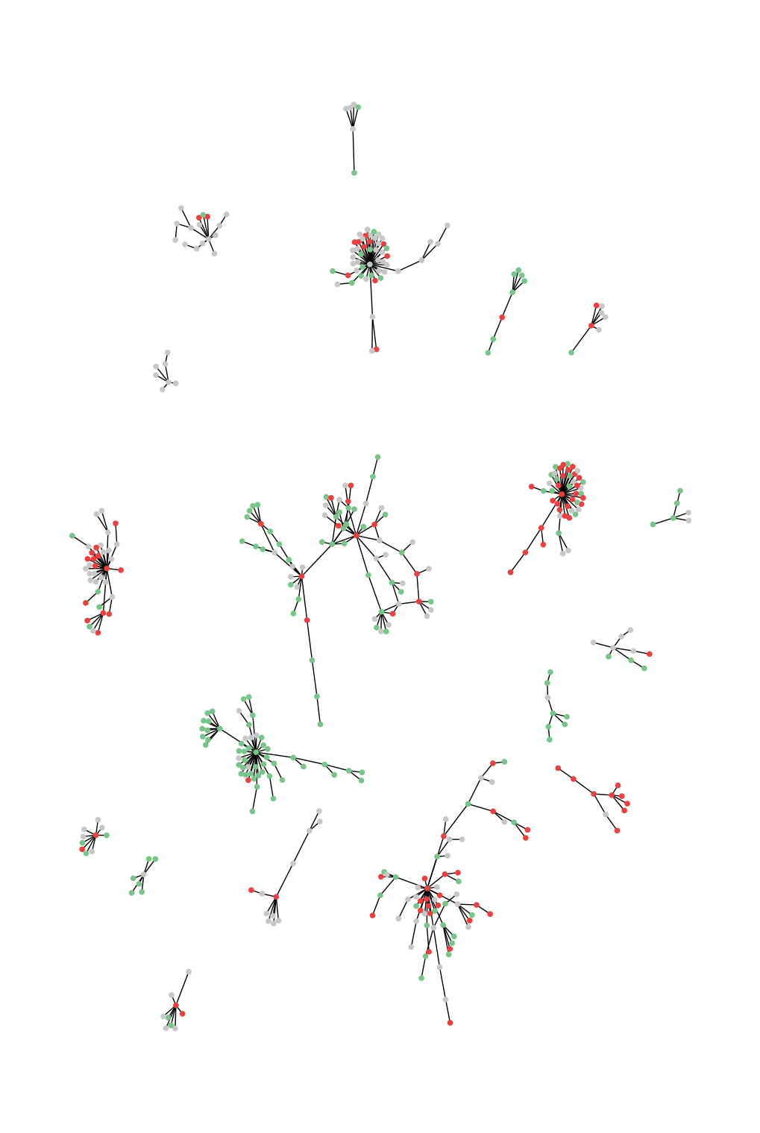
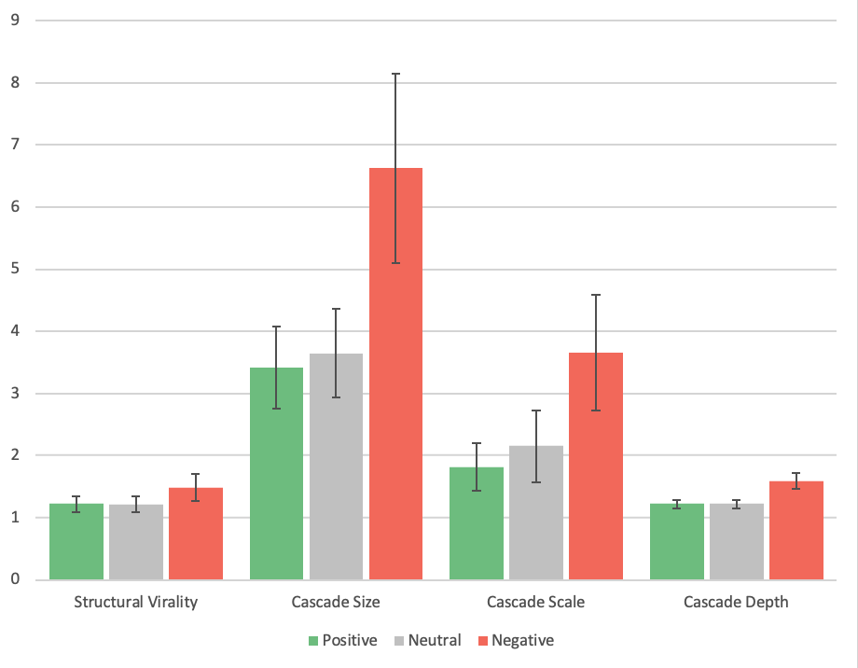
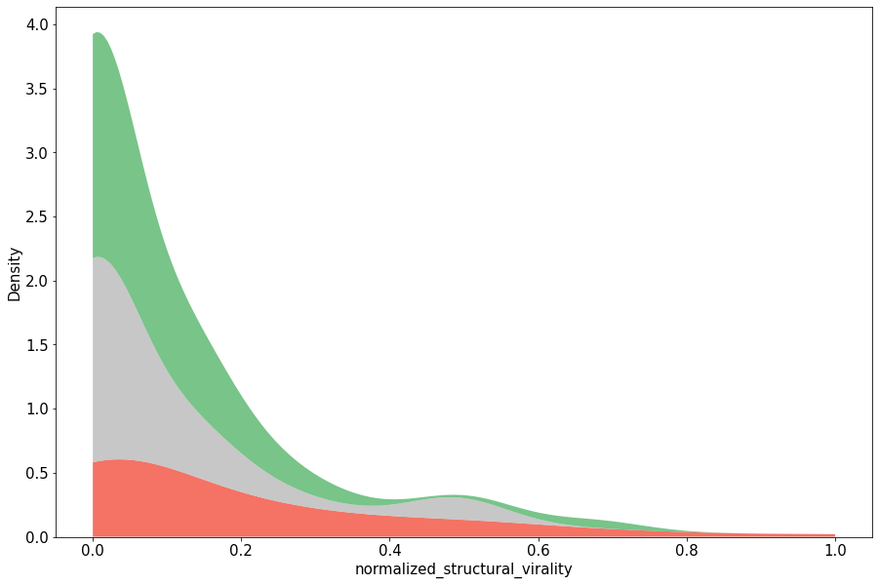
Broadcast Model and Echo Chambers
Diffusion tree construction and structural virality score (Liang et al., 2019)
p=0.033
Low virality Broadcast
High virality Peer-to-peer
Echo chambers
p=0.041
Distribution of normalized structural virality scores
p=0.005
p=0.009
p=0.003
p=0.007

Slide 12
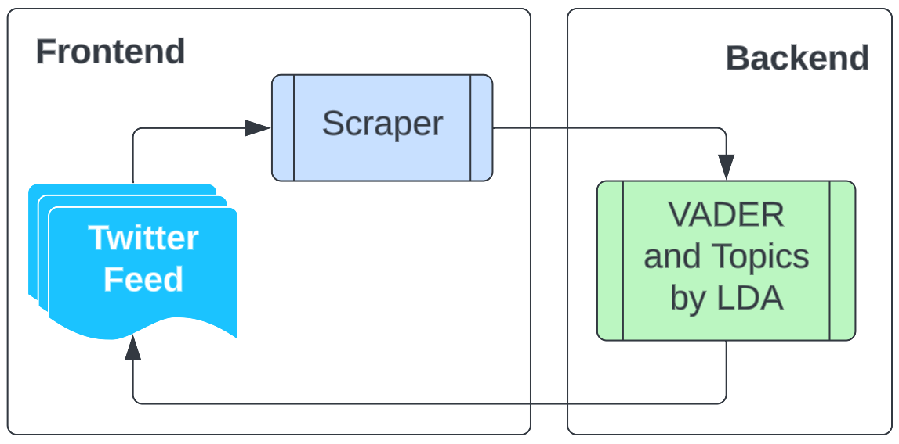
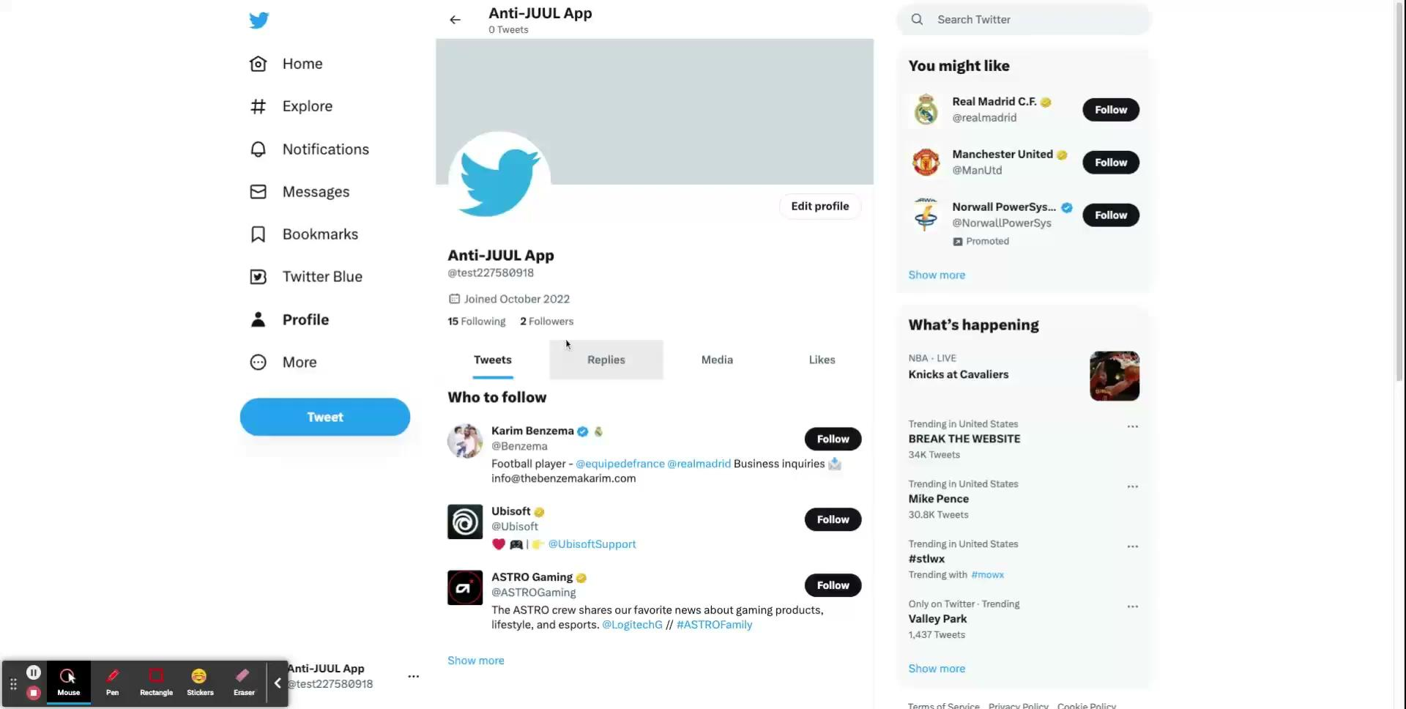
Preventative Strategy Integration with Twitter

Slide 13
Limitations and Future Directions
Twitter API constraints
No deleted or archived tweets
Only quote and recent retweets
Diffusion tree structure bias
Tweet length bias
Multi-source analysis
Behavioral analysis
Public health responses

Slide 14
Conclusions
Comprehensive 8 year analysis, 18x previous study size
EC perception generally positive
Marketing, flavors, social appeal, smoking cessation
Tobacco-21 state policies
Echo chambers
Lack of central authorities
Growing sentiment polarization
Mainstream events impact online discussions
Demonstration of preventative action tool
Blueprint for future studies in other domains and platforms

Slide 15
References
Ahmed, W., Marin-Gomez, X., & Josep Vidal-Alaball. (2020). Contextualising the 2019 E-Cigarette Health Scare: Insights from Twitter. International Journal of Environmental Research and Public Health, 17(7), 2236–2236. https://doi.org/10.3390/ijerph17072236
Allem, J.-P., Dharmapuri, L., Unger, J. B., & Cruz, T. B. (2018). Characterizing JUUL-related posts on Twitter. Drug and Alcohol Dependence, 190, 1–5. https://doi.org/10.1016/j.drugalcdep.2018.05.018
Allem, J. P., Ferrara, E., Uppu, S. P., Cruz, T. B., & Unger, J. B. (2017). E-Cigarette Surveillance With Social Media Data: Social Bots, Emerging Topics, and Trends. JMIR Public Health and Surveillance, 3(4), e98. https://doi.org/10.2196/publichealth.8641
Camenga, D., Gutierrez, K. M., Kong, G., Cavallo, D., Simon, P., & Krishnan-Sarin, S. (2018). E-cigarette advertising exposure in e-cigarette naïve adolescents and subsequent e-cigarette use: A longitudinal cohort study. Addictive Behaviors, 81, 78–83. https://doi.org/10.1016/j.addbeh.2018.02.008
Casey, B. J., & Jones, R. M. (2010). Neurobiology of the Adolescent Brain and Behavior: Implications for Substance Use Disorders. The Journal of the American Academy of Child and Adolescent Psychiatry, 49(12), 1189–1201. https://doi.org/10.1016/j.jaac.2010.08.017
Edo-Osagie, O., De La Iglesia, B., Lake, I., & Edeghere, O. (2020). A scoping review of the use of Twitter for public health research. Computers in Biology and Medicine, 122, 103770. https://doi.org/10.1016/j.compbiomed.2020.103770
Gao, Y., Xie, Z., & Li, D. (2021). Electronic Cigarette Users’ Perspective on the COVID-19 Pandemic: Observational Study Using Twitter Data. JMIR Public Health and Surveillance, 7(1), e24859–e24859. https://doi.org/10.2196/24859
Gaur, S., & Agnihotri, R. (2018). Health Effects of Trace Metals in Electronic Cigarette Aerosols—a Systematic Review. Biological Trace Element Research, 188(2), 295–315. https://doi.org/10.1007/s12011-018-1423-x
Hutto, C., & Gilbert, E. (2014). VADER: A Parsimonious Rule-Based Model for Sentiment Analysis of Social Media Text. Proceedings of the International AAAI Conference on Web and Social Media, 8(1), 216-225. https://doi.org/10.1609/icwsm.v8i1.14550
Jackler, R. K., Chau, C., Getachew, B. D., & Ramamurthi, D. (2019). JUUL Advertising Over its First Three Years on the Market. SRITA.https://tobacco.stanford.edu/
Liang, H., Fung, I.CH., Tse, Z.T.H., Yin, J., Chan, CH., Pechta, L.E., Smith, B.J., Marquez-Lameda, R.D., Meltzer, M.I., Lubell, K.M., Fu, KW (2019). How did Ebola information spread on twitter: broadcasting or viral spreading?. BMC Public Health 19, 438. https://doi.org/10.1186/s12889-019-6747-8
Malik, A., Li, Y., Karbasian, H., Hamari, J., & Johri, A. (2019). Live, Love, Juul: User and Content Analysis of Twitter Posts about Juul. American Journal of Health Behavior, 43(2), 326–336. https://doi.org/10.5993/ajhb.43.2.9 Majmundar, A., Allem, J.-P., Tess Boley Cruz, Unger, J. B., & Mary Ann Pentz. (2021). Twitter Surveillance at the Intersection of the Triangulum. Nicotine & Tobacco Research, 24(1), 118–124. https://doi.org/10.1093/ntr/ntab085
McCausland, K., Maycock, B., Leaver, T., Wolf, K., Freeman, B., & Jonine Jancey. (2020). E-Cigarette Advocates on Twitter: Content Analysis of Vaping-Related Tweets. JMIR Public Health and Surveillance, 6(4), e17543–e17543. https://doi.org/10.2196/17543
Myslín, M., Zhu, S.-H., Chapman, W., & Conway, M. (2013). Using Twitter to Examine Smoking Behavior and Perceptions of Emerging Tobacco Products. Journal of Medical Internet Research, 15(8). https://doi.org/10.2196/jmir.2534
Pepper, J. K., Farrelly, M. C., & Watson, K. A. (2018). Adolescents’ understanding and use of nicotine in e-cigarettes. Addictive Behaviors, 82, 109–113. https://doi.org/10.1016/j.addbeh.2018.02.015
Prier, K., Smith, M., Giraud-Carrier, C., Hanson, L. C. (2011). Identifying Health-Related Topics on Twitter An Exploration of Tobacco-Related Tweets as a Test Topic. Lecture Notes in Computer Science, 6589, 18-25. https://doi.org/10.1007/978-3-642-19656-0_4
Results from the annual National Youth Tobacco Survey (NYTS). U.S. Food and Drug Administration. Retrieved October 3, 2022, from https://www.fda.gov/tobacco-products/youth-and-tobacco/results-annual-national-youth-Tobacco-survey
Sailunaz, K., & Alhajjab, R. (2019). Emotion and sentiment analysis from Twitter text. Journal of Computational Science, 36. https://doi.org/10.1016/j.jocs.2019.05.009
Saravia, E., Liu, H.-C. T., Huang, Y.-H., Wu, J., & Chen, Y.-S. (2018). CARER: Contextualized Affect Representations for Emotion Recognition. Proceedings of the 2018 Conference on Empirical Methods in Natural Language Processing. https://doi.org/10.18653/v1/d18-1404
Sloan, L., Morgan, J., Burnap, P., & Williams, M. (2015). Who Tweets? Deriving the Demographic Characteristics of Age, Occupation and Social Class from Twitter User Meta-Data. PLOS ONE, 10(3), e0115545. https://doi.org/10.1371/journal.pone.0115545
Visweswaran, S., Colditz, J. B., O'Halloran, P., Han, N.-R., Taneja, S. B., Welling, J., Chu, K.-H., Sidani, J. E., & Primack, B. A. (2020). Machine Learning Classifiers for Twitter Surveillance of Vaping: Comparative Machine Learning Study. Journal of Medical Internet Research, 22(8). https://doi.org/10.2196/17478

